Slide 1
CPSC 375 Introduction to Data Science and Big Data Analytics
Dr. Anand Panangadan
apanangadan@fullerton.edu

Slide 2
What we will cover this week
Linear modeling
In R

Slide 3
What is a Math Model?
Model
Representation of a phenomenon
Describes the relationship between variables
Mathematical model
Numerically describe relationship between variables
“All models are wrong, but some are useful”
Notes:
.

Slide 4
Regression Model
Relationship between one dependent variable and explanatory variable(s)
Dependent variable is continuous
One equation describes the relationship
MODEL
Explanatory variables
Dependent variable

Slide 5
Steps to modeling
Define a family of models
Specify the generic pattern of relationship between variables
Linear, Quadratic, …
Fit the model to the data
Identify the “best” model from the family of models
Give values to the model parameters

Slide 6
Types of Regression Models
Regression Models
One explanatory variable
Multiple explanatory variables
Simple
Multiple
Linear
Non-Linear
Linear
Non-Linear
Notes:
24

Slide 7
Class work
Consider the problem of estimating Height given Weight and Age
What are some linear models for this?
What are some nonlinear models for this?

Slide 8
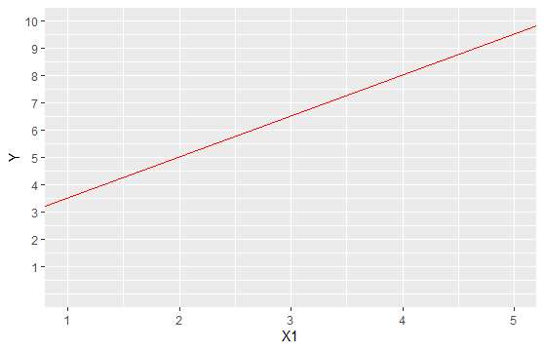

Linear Regression Model
Relationship between variables is a linear function
$$Y=β_{0}{+{ β}_{1}X}_{1}$$
Dependent (Response) Variable
Slope
Intercept
Independent (Explanatory) Variable

Slide 9
Interpretation of Coefficients
1. Slope
per unit change in the dependent variable for each unit change in the independent variable.
2. Y-Intercept
Average Value of Y When X = 0

Slide 10
Class work
How does Petal.Length change with Petal.Width?
Which is the dependent variable? Which is the explanatory/independent variable?
Draw a scatterplot
Draw any straight line that fits the data well
Use geom_abline()
?geom_abline

Slide 11
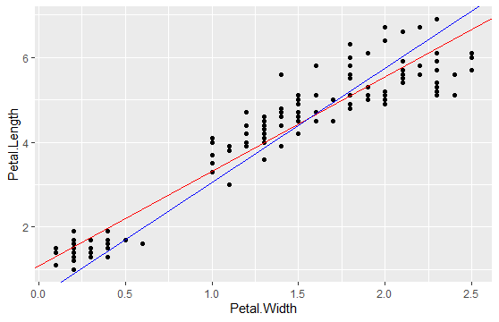
Which model/line is better?
Notes:
45

Slide 12
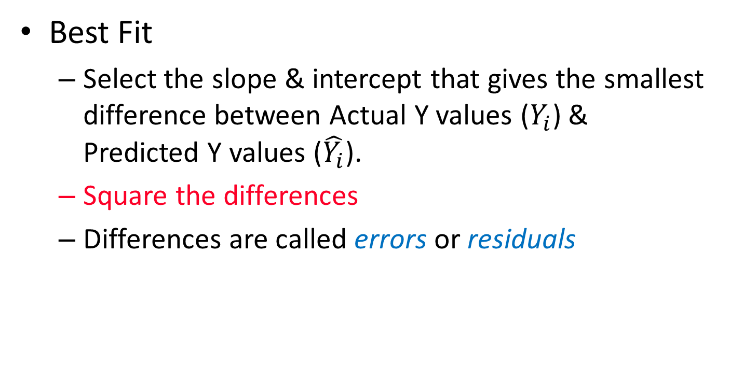

Least Squares (LS)
Best Fit
Select the slope & intercept that gives the smallest difference between Actual Y values ($Y_{i}$) & Predicted Y values ($\hat{Y_{i}}$).
Square the differences
Differences are called errors or residuals
$$\sum_{i=1}^{n}{{\left(Y_{i}−\hat{Y_{i}}\right)}^{2}}=\sum_{i=1}^{n}{ε_{i}^{2}}$$
Notes:
51

Slide 13
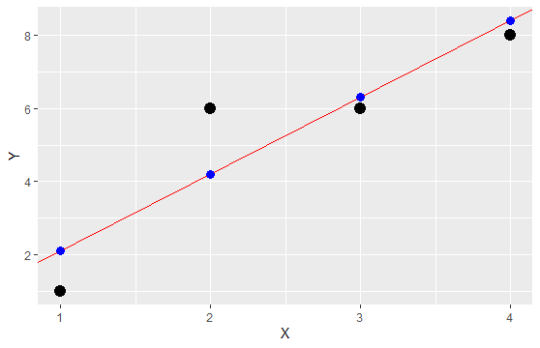









Least Squares Graphically
LS minimizes $∑ε_{i}^{2}=ε_{1}^{2}+ε_{2}^{2}+ε_{3}^{2}+ε_{4}^{2}$
$$Y_{4}$$
$$Y_{2}$$
$$Y_{3}$$
$$ε_{2}$$
$$\hat{Y_{2}}$$
$$\hat{Y_{1}}$$
$$ε_{1}$$
$$Y_{1}$$
Notes:
52

Slide 14
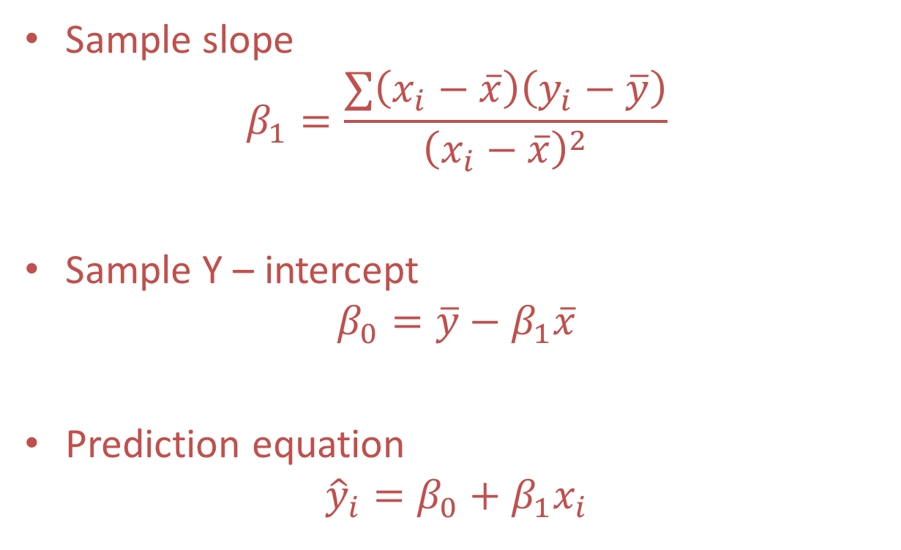
LS minimization is efficient!
Sample slope
$$β_{1}=\frac{∑\left(x_{i}−\overline{x}\right)\left(y_{i}−\overline{y}\right)}{{\left(x_{i}−\overline{x}\right)}^{2}}$$
Sample Y – intercept
$$β_{0}=\overline{y}−β_{1}\overline{x}$$
Prediction equation
$${\hat{y}}_{i}=β_{0}+β_{1}x_{i}$$

Slide 15
When can we use LM?
One dependent variable
Dependent variable is continuous

Slide 16
Linear Regression in R
lm function
lm(y~x)
y~x is formula
y,x: names of dependent/independent variables
lm(Petal.Length~Petal.Width, data=iris)
Store resulting model
m <- lm(Petal.Length~Petal.Width, data=iris)
m will be used for
Evaluation
prediction

Slide 17
Summary(lm model)
> summary(m)
Call:
lm(formula = Petal.Length ~ Petal.Width, data = iris)
Residuals:
Min 1Q Median 3Q Max
-1.33542 -0.30347 -0.02955 0.25776 1.39453
Coefficients:
Estimate Std. Error t value Pr(>|t|)
(Intercept) 1.08356 0.07297 14.85 <2e-16 ***
Petal.Width 2.22994 0.05140 43.39 <2e-16 ***
---
Signif. codes:
0 ‘***’ 0.001 ‘**’ 0.01 ‘*’ 0.05 ‘.’ 0.1 ‘ ’ 1
Residual standard error: 0.4782 on 148 degrees of freedom
Multiple R-squared: 0.9271, Adjusted R-squared: 0.9266
F-statistic: 1882 on 1 and 148 DF, p-value: < 2.2e-16

Slide 18
Coefficients from lm
cf <- m$coefficients #or
cf <- coef(m)

Slide 19
Plot the model
ggplot(data=iris) +
geom_abline(slope=cf[2], intercept=cf[1])

Slide 20
Class work
Consider the “Auto MPG” dataset which “concerns city-cycle fuel consumption in miles per gallon, to be predicted in terms of 3 multivalued discrete and 5 continuous attributes.” The goal is to model mpg given engine displacement.
Load the autompg.csv file on Canvas
Which is the dependent variable? Which is the independent variable?
Plot mpg vs. displacement (code, plot)
Overlay best fit line over the dataset (code, plot)

Slide 21
When should we use LM?
Is the “best” fit model a good model?!
Evaluating the model
Two conflicting objectives
Goodness-of-Fit
We want model to match the data
Complexity
We want model to be “simple”
“Principle of parsimony”
Find a model that is as simple as possible without sacrificing too much goodness-of-fit

Slide 22
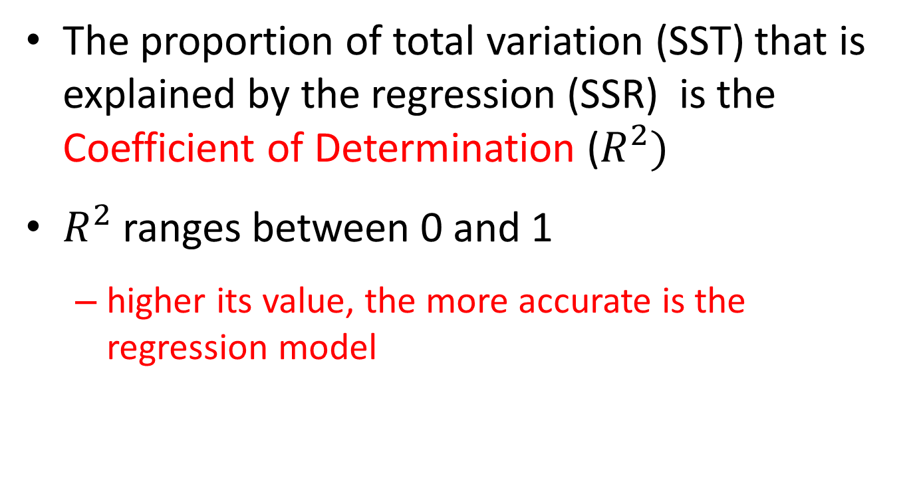
Coefficient of Determination
The proportion of total variation (SST) that is explained by the regression (SSR) is the Coefficient of Determination ($R^{2})$
$R^{2}$ ranges between 0 and 1
higher its value, the more accurate is the regression model

Slide 23
Sum of Squares of Error (SSE)
Dependent variable
Independent variable (x)
A least squares regression selects the line with the lowest total sum of squared prediction errors.
This value is called the Sum of Squares of Error (SSE)
This is the “unexplained” variation

Slide 24

Sum of Squares Regression (SSR)
Population mean: $\overline{y}$
Dependent variable
Independent variable (x)
The Sum of Squares Regression (SSR) is the sum of the squared differences between the prediction for each observation and the population mean.
This is the “explained” variation

Slide 25
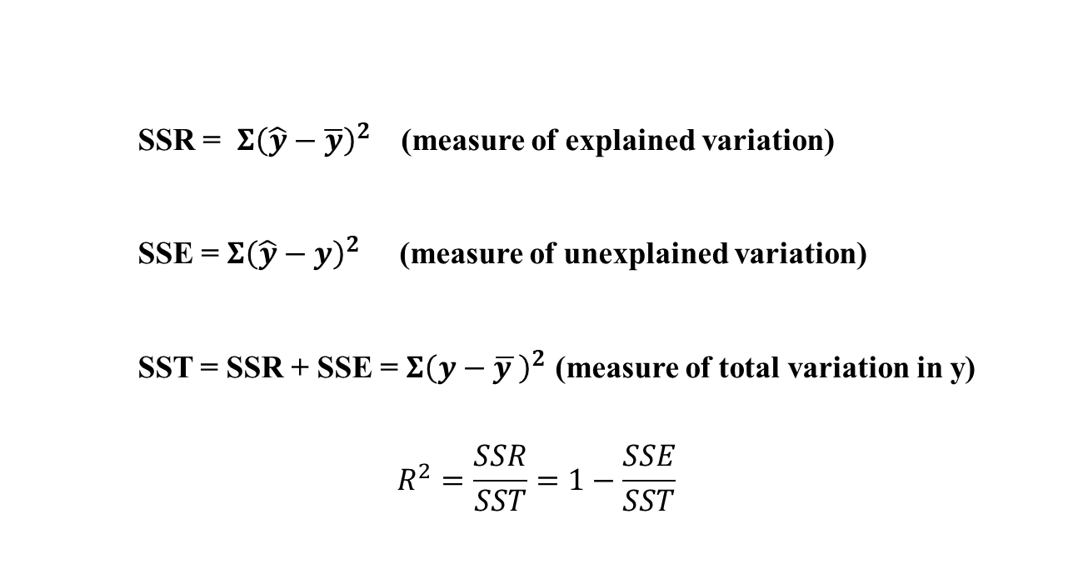
Total Sum of Squares (SST)
SSR = $Σ{\left(\hat{y}−\overline{y}\right)}^{2}$ (measure of explained variation)
SSE = $Σ{\left(\hat{y}−y\right)}^{2}$ (measure of unexplained variation)
SST = SSR + SSE = $Σ{\left(y−\overline{y }\right)}^{2}$ (measure of total variation in y)
$$R^{2}=\frac{SSR}{SST}=1−\frac{SSE}{SST}$$

Slide 26
Regression Coefficient Significance Tests
> summary(m)
Call:
lm(formula = Petal.Length ~ Petal.Width, data = iris)
Residuals:
Min 1Q Median 3Q Max
-1.33542 -0.30347 -0.02955 0.25776 1.39453
Coefficients:
Estimate Std. Error t value Pr(>|t|)
(Intercept) 1.08356 0.07297 14.85 <2e-16 ***
Petal.Width 2.22994 0.05140 43.39 <2e-16 ***
---
Signif. codes:
0 ‘***’ 0.001 ‘**’ 0.01 ‘*’ 0.05 ‘.’ 0.1 ‘ ’ 1
Residual standard error: 0.4782 on 148 degrees of freedom
Multiple R-squared: 0.9271, Adjusted R-squared: 0.9266
F-statistic: 1882 on 1 and 148 DF, p-value: < 2.2e-16
>
Linear regression coefficients (estimated using least-squares) follow a t-distribution
lm() includes the standardized t value and a p-value for each coefficient
The smaller the p-value, the stronger the evidence against the null hypothesis: the coefficient is 0
i.e., there is strong evidence for the claim that the predictor has an effect

Slide 27
Regression Diagnostics
The three conditions required for the validity of the regression analysis are:
the error variable is normally distributed
the error variance is independent of x
The errors are independent of each other
How can we diagnose violations of these conditions?

Slide 28
Residuals
Prediction equation:
y = x * c[2] + c[1]:
fitted.values(m)
residuals <- y – (x*c[2] + c[1])
Same as
residuals(m)

Slide 29
Residual Analysis
Examine the residuals
Non-normality.
Examine the residual histogram and look for a bell shaped curve with a mean close to zero
library(modelr)
irisCopy <- iris %>% add_residuals(mod)
gplot(data=irisCopy) + geom_histogram(mapping = aes(x=resid))

Slide 30
Residual Analysis
Plot a scatterplot
Residuals vs x
Points should appear to be randomly scattered around zero
library(modelr)
irisCopy <- iris %>% add_residuals(mod)
gplot(data=irisCopy) + geom_point(mapping = aes(x=Petal.Width, y=resid))

Slide 31
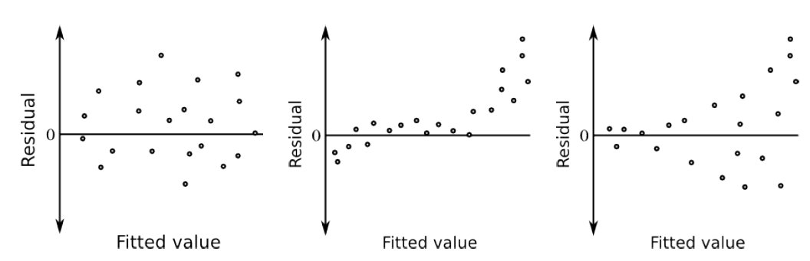
Residuals appear randomly scattered around zero, and their spread
appears constant
✓
systematic behavior in the residuals

Residuals scattered randomly about zero but variability isn’t constant

homoscedasticity
heteroscedasticity

Slide 32
Outliers
Outlier: an observation that is unusually small or large
Several possibilities need to be investigated when an outlier is observed:
There was an error in recording the value.
The point does not belong in the sample.
The observation is valid.
Suspect an observation is an outlier if its
|standardized residual| > 2

Slide 33
Standardized Residuals
mod <- lm(Petal.Length~Petal.Width, data=iris)
rstandard(mod)
irisStdRes <- iris %>% cbind(stdres=rstandard(mod))
Classwork:
Which rows of iris are outliers based on the Petal.Width~Petal.Length model?
Notes:
irisStdRes %>% filter(resid > 2 | resid < -2)

Slide 34
Making predictions
The fitted model can be used to make predictions for new x values
For accuracy, x should be within the range seen in the data used for modeling (interpolation)
Data.frame used for prediction must have the same variable names as in the model
predx <-data.frame(Petal.Width=c(0.5, 1.0, 2.0))
predict(mod, predx)

Slide 35
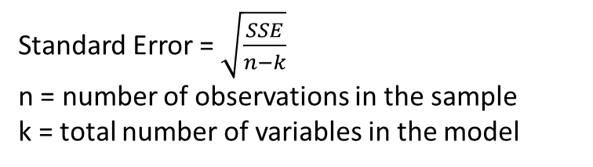
Standard Error
Calculating Standard Error of the regression is used for calculating
prediction intervals
confidence intervals
Standard Error = square root of the average prediction error.
Standard Error = $\sqrt{\frac{SSE}{n−k}}$
n = number of observations in the sample
k = total number of variables in the model

Slide 36
Prediction interval
For a given value of x, the interval estimate of the dependent variable is called the prediction interval
predict(mod, newdata=predx, interval="prediction", level=0.95)
fit lwr upr
1 2.198528 1.247734 3.149323
2 3.313499 2.365144 4.261853
3 5.543439 4.591820 6.495058

Slide 37
Confidence interval
For a given value of x, the interval estimate for the mean of the dependent variable is called the confidence interval
predict(mod, newdata=predx, interval="confidence", level=0.95)
fit lwr upr
1 2.198528 2.093655 2.303401
2 3.313499 3.233728 3.393269
3 5.543439 5.431339 5.655539
Note: the confidence interval is smaller than the prediction interval
We are more certain of the mean predictions than of any one prediction

Slide 38
Procedure for Regression Diagnostics
Gather data for the variables in the model
Draw a scatterplot to determine whether a linear model appears to be appropriate
Determine the regression equation (lm)
Check the required conditions for the errors (residual analysis)
Check the existence of outliers
Assess the model fit (R²)
If the model fits the data, use the model to predict new values (predict)

Slide 39
Why is LR important?
Simple
Efficient
Assumptions are reasonable
Model is surprisingly powerful
Multiple predictor variables
Can use transformed predictors

Slide 40
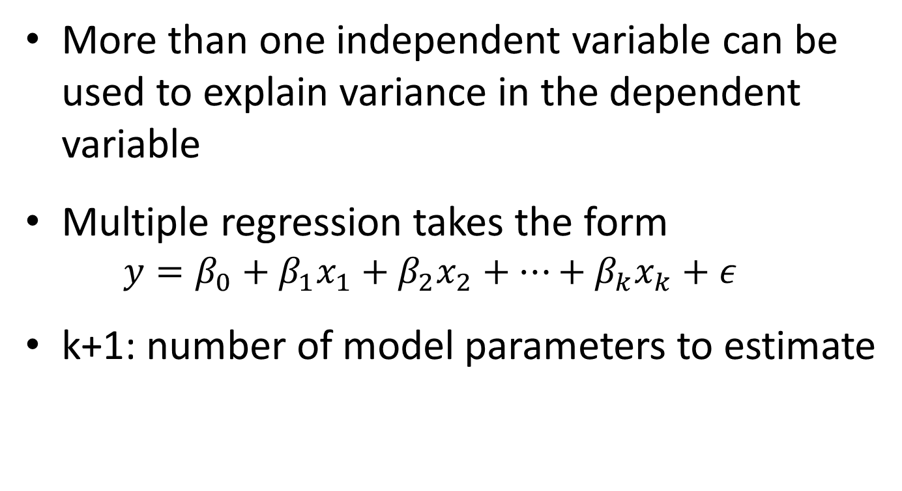
Multiple Linear Regression
More than one independent variable can be used to explain variance in the dependent variable
Multiple regression takes the form
$$y=β_{0}+β_{1}x_{1}+β_{2}x_{2}+…+β_{k}x_{k}+ε$$
k+1: number of model parameters to estimate

Slide 41
Classwork
Write down the linear model equation relating the three variables from
Petal.Width ~ Petal.Length + Sepal.Length

Slide 42
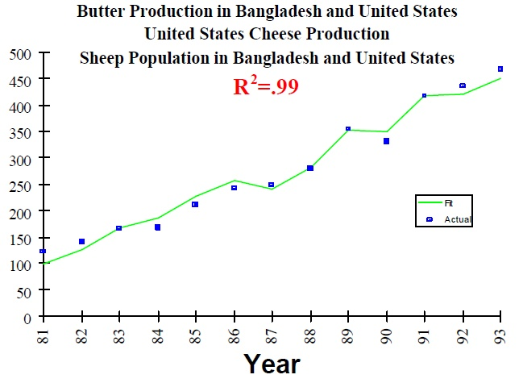
Adjusted R2
Will adding more independent variables always reduce R2?
What if the independent variables are completely random?
Surprisingly, yes!
Must focus on number of variables
More variables → less trustworthy model
Adjusted R2
Adjusts for the number of variables by reducing R2
for more complex models
Overfitting: A particular problem in Big Data
How to get a high R2 model for the S&P 500?!

Slide 43
Transforming predictors: categorical variables
Transform categorical variables using 0-1 dummy variables
Z=0 if value = ClassA
Z=1 if value ≠ ClassA
If categorical variable takes n values, create
n-1 binary variables

Slide 44
Transforming predictors: categorical variables
Example: Species variable in iris dataset
Factor with 3 levels: setosa, versicolor, virginica
setosa becomes the reference value
no dummy variable
First dummy variable for versicolor
=1 when Species=versicolor
=0 otherwise
Second dummy variable for virginica
=1 when Species= virginica
=0 otherwise
Value | Dummy variable 1 | Dummy variable 2
Setosa | 0 | 0
Versicolor | 1 | 0
Virginica | 0 | 1

Slide 45
Classwork
Do 0-1 coding of sem={Freshman, Soph, Junior, Senior}

Slide 46
Classwork
Do 0-1 coding of sem={Freshman, Soph, Junior, Senior}
3 dummy variables
 | semSoph | semJunior | semSenior
Freshman | 0 | 0 | 0
Soph | 1 | 0 | 0
Junior | 0 | 1 | 0
Senior | 0 | 0 | 1

Slide 47
Multiple parallel lines with a categorical variable
Build a linear model to predict Petal.Length given Petal.Width and Species
What is the linear regression equation?

Slide 48
Multiple parallel lines with a categorical variable
Build a linear model to predict Petal.Length given Petal.Width and Species
What is the linear regression equation?
Petal.Length = 1.21140 + (1.01871 * Petal.Width) + (1.69779 * Speciesversicolor) + (2.27669 * Speciesvirginica)
If (Species == setosa)
Petal.Length = 1.21140 + (1.01871 * Petal.Width) + (1.69779 * Speciesversicolor) + (2.27669 * Speciesvirginica)
Petal.Length = 1.21140 + (1.01871 * Petal.Width)
If (Species == versicolor)
Petal.Length = 1.21140 + (1.01871 * Petal.Width) + (1.69779 * 1) + (2.27669 * Speciesvirginica)
Petal.Length = (1.21140 +1.69779)+ (1.01871 * Petal.Width)
If (Species == virginica)
Petal.Length = 1.21140 + (1.01871 * Petal.Width) + (1.69779 * 0) + (2.27669 * 1)
Petal.Length = (1.21140 + 2.27669) + (1.01871 * Petal.Width)

Slide 49
Visualizing the linear model with categorical variables
Multiple lines
Each dummy variable creates its own line
Example: Species variable in iris dataset
Plot all lines represented by the linear model
plot the predictions
use add_predictions() and geom_line() and use the color aesthetic for the categorical variable

Slide 50
Classwork
Consider the autompg.csv dataset on Canvas. The goal is to model mpg given engine displacement (a continuous variable) and number of cylinders (pretend this is a categorical variable).
Which is the dependent variable? Which are the independent variables?
Load the autompg.csv file on Canvas and convert cylinders variable to a factor
Create a linear model called mod_displ_cyl of mpg vs. displacement and cylinders.
Give R code, output of summary(mod_displ_cyl)
How many dummy (i.e., 0-1) variables were created in the model?
What are they called?
Give the model equations relating mpg with displacement and cylinders.
Plot mpg vs. displacement and overlay the best fit model. (code, plot)
Hint: plot the predictions; use add_predictions() and geom_line() and use the color aesthetic for cylinders

Slide 51
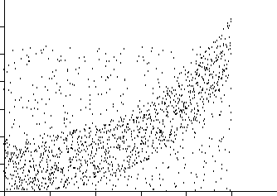
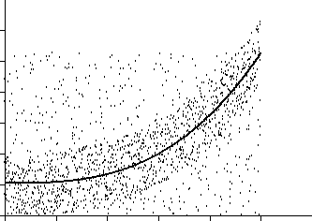
Transforming predictors
Nonlinear Regression
Nonlinear functions can also be fit as regressions. Common choices include Power, Logarithmic, Exponential, and Logistic, but any continuous function can be used.

Slide 52
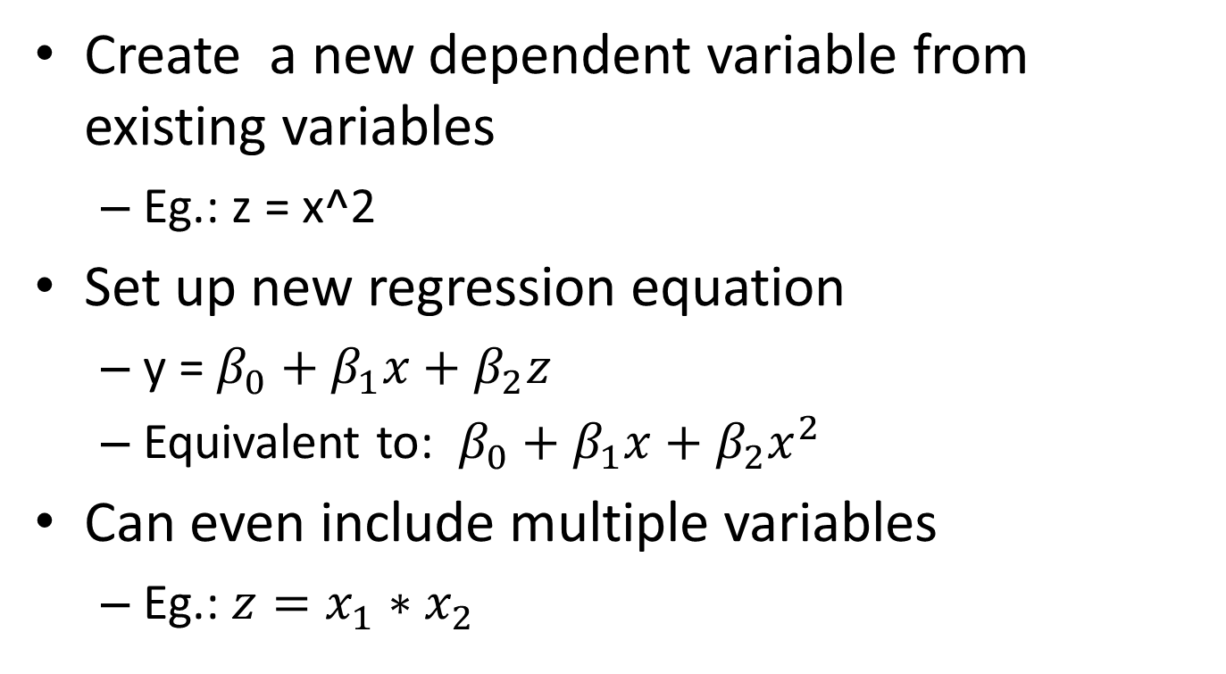
Transforming predictors
Create a new dependent variable from existing variables
Eg.: z = x^2
Set up new regression equation
y = $β_{0}+β_{1}x+β_{2}z$
Equivalent to: $β_{0}+β_{1}x+β_{2}x^{2}$
Can even include multiple variables
Eg.: $z=x_{1}∗x_{2}$

Slide 53
Classwork: nonlinear transformation
For the iris dataset
Build a linear model to predict Petal.Length given:
Petal.Width²
What is the linear regression equation?
Plot the linear model

Slide 54
Visualize the model with transformed variable
How to plot both the points and the model?
The linear model is a straight line only with the transformed variables, not the original variables
The “trick”
Create a new dataset just for prediction
data_grid(var): creates a data frame with only unique values of the variable var

Slide 55
Visualize the model with transformed variable
library(modelr) #tidyverse library with useful functions
# create a new dataset with only unique values of the independent variable (displ)
mygrid <- mpg %>% data_grid(displ)
# add a new transformed variable as before
mygrid <- mygrid %>% mutate(displ_exp = exp(-displ))
# add predictions from the model
mygrid <- mygrid %>% add_predictions(mod)
# overlay a line using the new dataset
ggplot(data=mpg) +
geom_point(mapping = aes(x=displ, y=cty)) +
geom_line(data=mygrid, mapping=aes(x=displ, y=pred), color="blue")

